Slide 1

Fake news detection using machine learning

Slide 2
Objective

Slide 3
The rapid rise of internet use and social media has fueled the spread of fake news, profoundly affecting politics, economics, and public opinion. Often circulated for profit or entertainment, fake news influenced events like the 2016 US presidential election and caused social media disruptions during the COVID-19 pandemic. This issue has undermined trust and intensified societal concerns.
Researchers are exploring the phenomenon using terms such as "rumors" and "misinformation" to understand its impact. Efforts to address fake news include methods like binary classification (real vs. Fake), multiclass classification, regression, and clustering, highlighting its complexity and significance.
Researchers employ diverse methods to classify fake news: propagation-based approaches track sharing trends and audience responses, user profile-based techniques analyze user behavior and metadata like location or followers, and content-based strategies focus on linguistic features (syntactic) or the text's structure and meaning (semantic).

Slide 4
Model summary

Slide 5
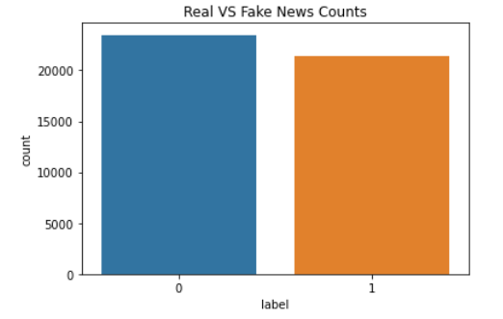
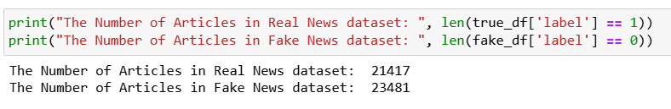
ISOT Fake News Dataset: https://www.kaggle.com/Datasets/Emineyetm/Fake-news-detection-datasets
Code Link: https://drive.google.com/file/d/1ZJVsjDuKxGXfGbZQ4ZcrVA5-C5FoHWNb/view?usp=sharing

Slide 6


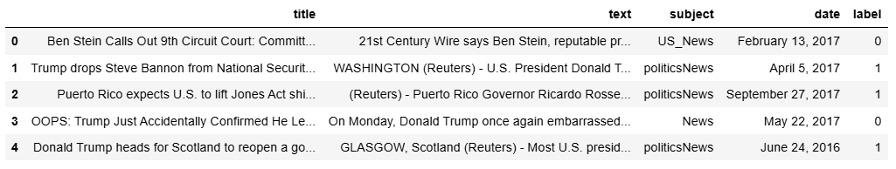
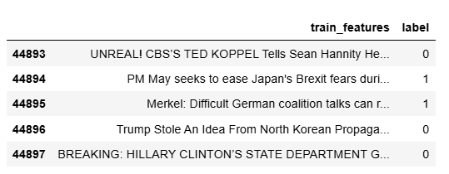
A part of the dataset is uncleaned
A part of the dataset is cleaned

Slide 7
Approach

Slide 8

Data Preprocessing
Lowercase
Removal of unwanted non-alphabetic characters
Removal of:
brackets,
HTML Tags,
Punctuations,
Extra whitespaces
ISOT Fake News Dataset
Data Preprocessing

Slide 9
Data Partition
Training Set
70%
Dataset
Testing Set
30%

Slide 10


Feature Engineering
100010
111000
…..
TF-IDF
(TF-IDF=TF×IDF)
Term Frequency (TF): Measures how often a word appears in a document
Inverse Document Frequency (IDF): Reduces the weight of common words across documents and emphasizes rare words.

Slide 11

Machine Learning Models that are being trained on this dataset are:
Logistic Regression
Naive Bayes
Random Forest
Decision Tree
SVM
Voting Classifier
Gradient Boosting Classifier
XGBoost Classifier
AdaBoost Classifier

Slide 12
Evaluation Matrices

Slide 13
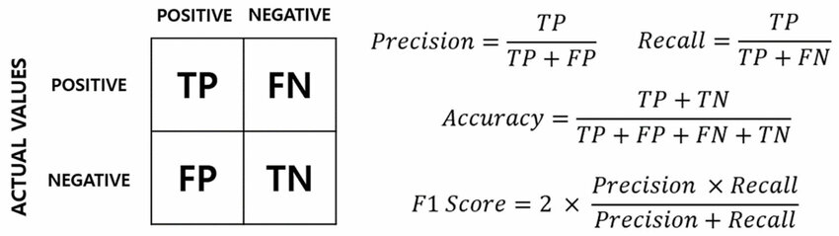

Slide 14
Results

Slide 15
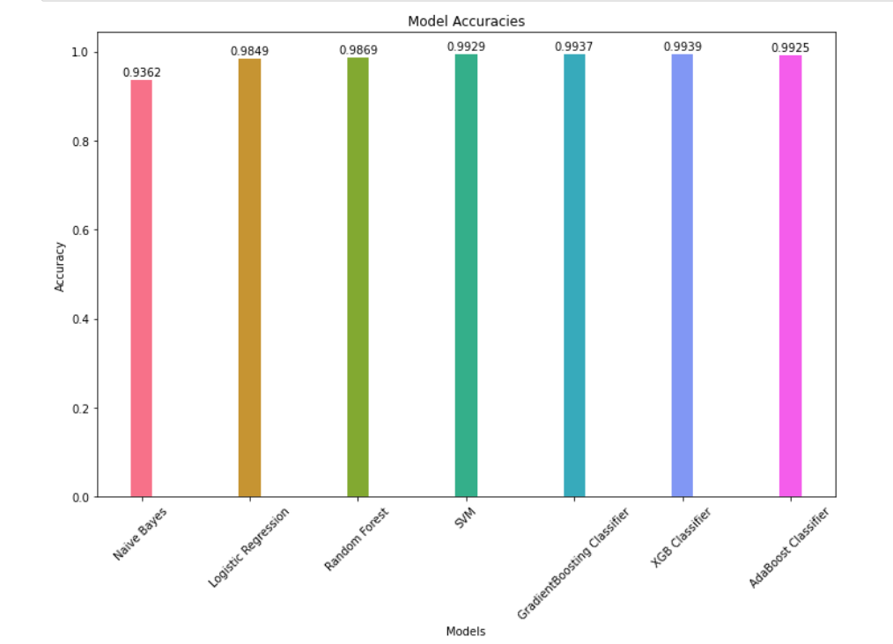
Model | Accuracy
Naïve Bayes | 0.9362
Logistic Regression | 0.9849
Random Forest | 0.9887
SVM | 0.9929
Gradient Boosting | 0.9937
XGBoost | 0.9939
AdaBoost | 0.9925

Slide 16
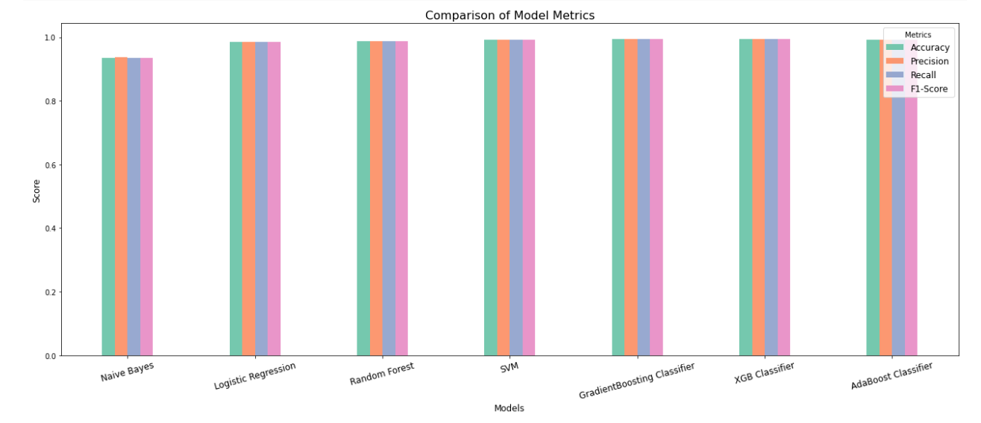
Models | Evaluation Metrics
 | Accuracy | Precision | Recall | F-score
Naïve Bayes | 0.9362 | 0.936379 | 0.936229 | 0.936185
Logistic Regression | 0.9849 | 0.984954 | 0.984929 | 0.984932
Random Forest | 0.9887 | 0.988717 | 0.988716 | 0.988715
SVM | 0.9929 | 0.992952 | 0.992947 | 0.992948
Gradient Boosting | 0.9937 | 0.99373 | 0.99369 | 0.993691
XGBoost | 0.9939 | 0.993947 | 0.993912 | 0.993913
AdaBoost | 0.9925 | 0.992567 | 0.992502 | 0.992504

Slide 17
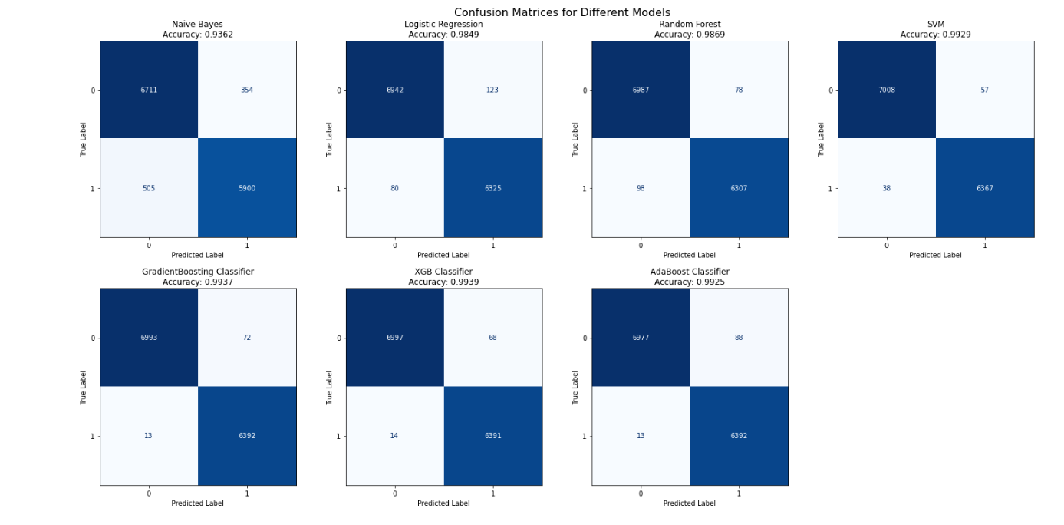

Slide 18
Inference

Slide 19
The top-performing classifiers include XGBOOST, RANDOM FOREST, and GRADIENT BOOSTING, each achieving an accuracy close to 0.99.
SUPPORT VECTOR MACHINE (SVM) stands out with an accuracy of 0.992 and consistently strong performance across other evaluation metrics. SVM’s ability to handle high-dimensional feature spaces and effectively determine decision boundaries likely contributes to its success in identifying fake news.
LOGISTIC REGRESSION and DECISION TREE CLASSIFIERS also deliver solid results, with accuracy ratings exceeding 0.98 and 0.99, respectively.
On the other hand, NAIVE BAYES exhibits the weakest performance among the classifiers tested. Its assumption of feature independence appears inadequate for capturing the complex relationships in fake news data, leading to its comparatively lower effectiveness.

Slide 20
Future works

Slide 21
Automated fake news detection offers an efficient solution to handle the vast online content and helps curb the rapid spread of misinformation on the internet and social media platforms.
A significant contribution is its emphasis on efficiently identifying fake news within the overwhelming volume of online content.
The study examines the integration of extra data sources, including user engagement metrics, social network analysis, and multimodal content (text, images, videos). It also looks into the advancement of more sophisticated machine learning models, such as deep learning and cutting-edge natural language processing methods. Furthermore, it tackles issues related to scalability, real-time detection, and the interpretability of fake news detection systems.

Slide 22
References

Slide 23
https://www.researchgate.net/publication/384091988_a_detecting_fake_news_using_machine_learning_a_comparative_study_of_techniques
https://www.researchgate.net/profile/feyisola-quadri/publication/376522519_fake_news_classification_using_machine_learning_models_a_review/links/657c21d9ea5f7f0205736b69/fake-news-classification-using-machine-learning-models-a-review.pdf
https://www.researchgate.net/profile/muhamamd-fayaz-2/publication/358214526_machine_learning_for_fake_news_classification_with_optimal_feature_selection/links/627dd2c13a23744a727b4c50/machine-learning-for-fake-news-classification-with-optimal-feature-selection.pdf?_sg%5b0%5d=started_experiment_milestone&_sg%5b1%5d=started_experiment_milestone&origin=journaldetail
https://arxiv.org/pdf/2203.09936

Slide 24
Thank you

